Slide 2
How to integrate ML.NET with a chat bot
Veronika Kolesnikova Microsoft MVP AI
@breakpointv16

Slide 3


Veronika Kolesnikova
Microsoft MVP AI
MS in Information Technology
3.5 years QA Experience
6+ years development experience
C#, .NET, SQL, Xamarin, .NET-based CMSes like EPiServer, Sitecore
PHP, MySQL, Drupal, RoR
Hobbies: dancing, travelling, aerial yoga

Slide 4
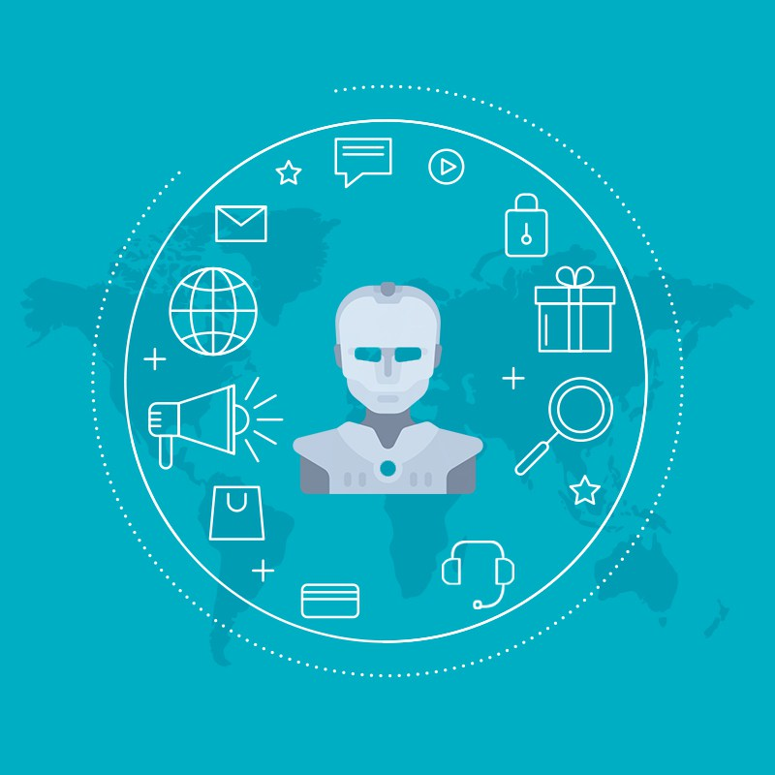
What is a bot?
Bot == Virtual Assistant ?
Microsoft offers:
Bot Framework SDK
Azure Web App Bot
Azure Bot Channels Registration
Microsoft Healthcare Bot
ML is in the core of every bot
Notes:
A virtual assistant, also called AI assistant or digital assistant, is an application program that understands natural language voice commands and completes tasks for the user

Slide 5
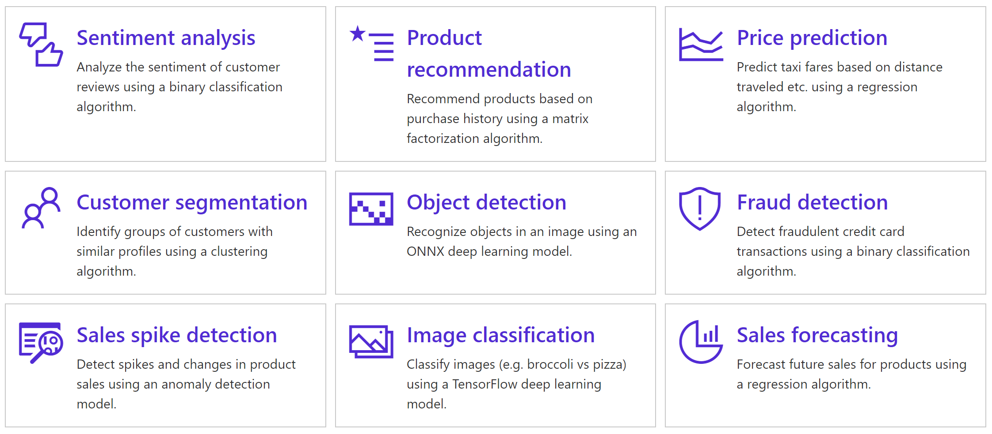
ML.NET
ML.NET allows you to train, build and ship custom machine learning models using C# or F# for scenarios such as sentiment analysis, issue classification, forecasting, recommendations and more.
github.com/dotnet/machinelearning

Slide 6
Demo

Slide 7
Thank you!

